Slide 1
Prostate-SR: Deep Learning Approach for Anisotropic MRI Reconstruction
Enhancing prostate MRI clarity using advanced deep learning methods
Notes:
AI-generated content may be incorrect. ---

Slide 2
Introduction and Abstract
Notes:
--- This slide references information from the following file: https://uflorida-my.sharepoint.com/personal/anany_sharma_ufl_edu/Documents/Microsoft%20Copilot%20Chat%20Files/Contribution_Title.pdf Abstract

Slide 3

Abstract
Anisotropic Resolution Issue
Prostate MRI suffers from low through-plane resolution causing blocky artifacts in reformatted views.
Single-Image Super-Resolution (SISR)
SISR baseline using ResNet significantly improves resolution over traditional interpolation methods.
Multi-Image Super-Resolution (MISR)
MISR framework uses adjacent slices to improve anatomical consistency and reduce flickering artifacts.
Clinical Impact and Validation
Validated on Prostate-MRI-US-Biopsy dataset, enhancing diagnostic accuracy and clinical workflows.
Notes:
--- This slide references information from the following file: https://uflorida-my.sharepoint.com/personal/anany_sharma_ufl_edu/Documents/Microsoft%20Copilot%20Chat%20Files/Contribution_Title.pdf Magnetic Resonance Imaging (MRI) of the prostate often suffers from anisotropic resolution, where the in-plane resolution is high but the through-plane resolution is significantly lower. This discrepancy leads to blocky artifacts when images are reformatted into sagittal or coronal views, which negatively impacts downstream tasks such as 3D segmentation and diagnostic accuracy. The proposed solution, Prostate-SR, introduces a deep learning-based framework for MRI super-resolution that addresses these limitations. The approach begins with establishing a strong Single-Image Super-Resolution (SISR) baseline using a Residual Network (ResNet) architecture. This baseline is then extended to a Multi-Image Super-Resolution (MISR) framework that leverages adjacent anatomical slices to improve structural fidelity and volumetric consistency. The study validates these methods on the Prostate-MRI-US-Biopsy dataset, demonstrating that while SISR significantly outperforms traditional bicubic interpolation, MISR provides superior anatomical continuity and reduces flickering artifacts across slices. The research emphasizes the importance of combining pixel-level accuracy with perceptual realism, ultimately aiming to enhance clinical workflows and diagnostic confidence in prostate cancer imaging.

Slide 4
Problem Statement
Notes:
--- This slide references information from the following file: https://uflorida-my.sharepoint.com/personal/anany_sharma_ufl_edu/Documents/Microsoft%20Copilot%20Chat%20Files/Contribution_Title.pdf Challenges in Anisotropic MRI

Slide 5
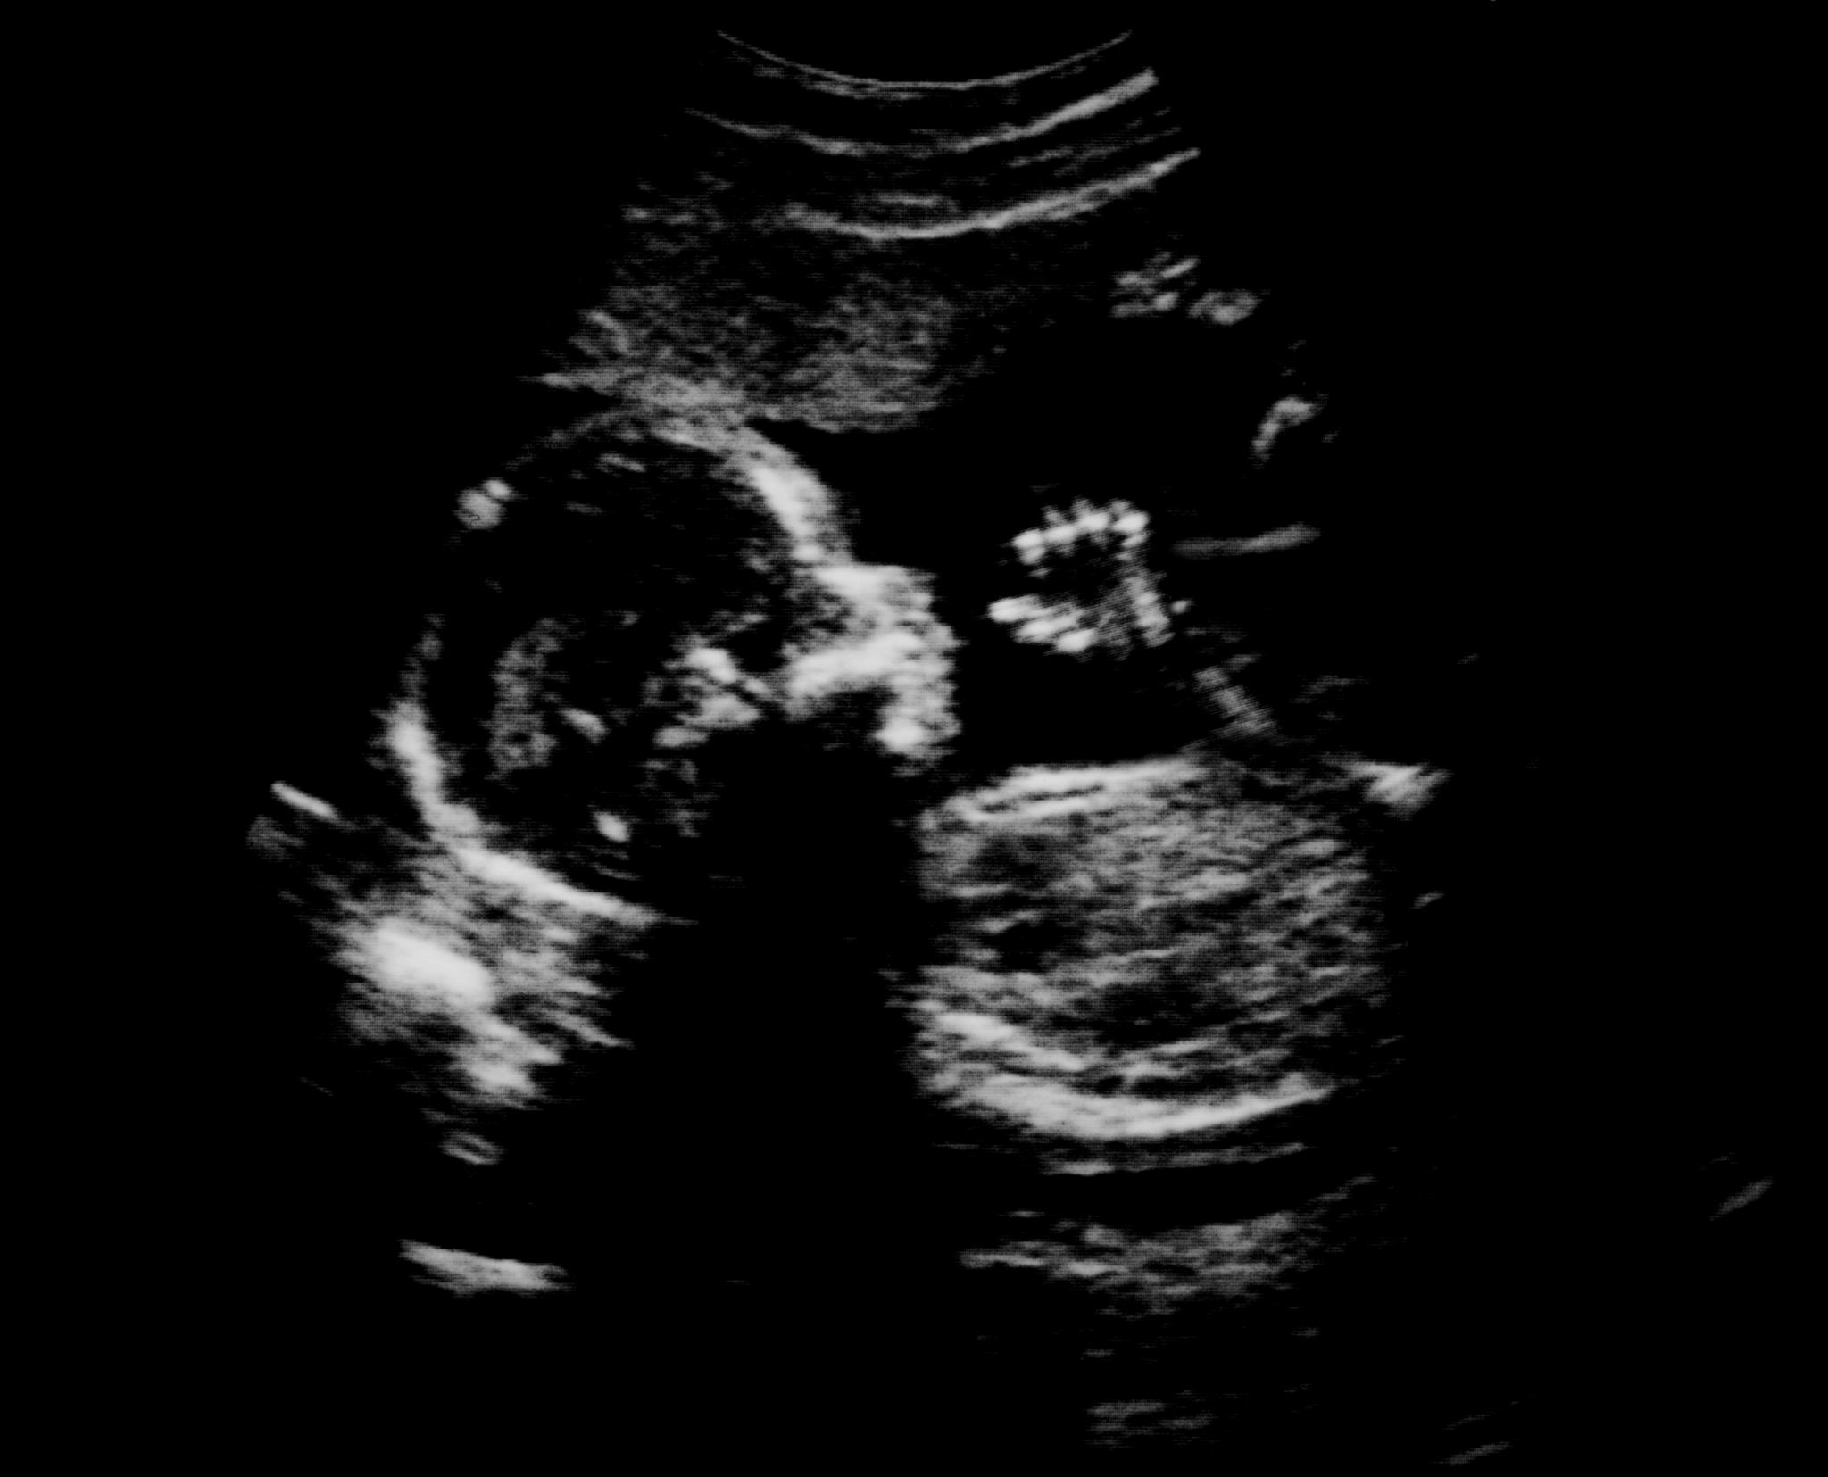
Challenges in Anisotropic MRI
Anisotropic Resolution Issues
High in-plane but poor through-plane resolution causes aliasing and blocky artifacts in reformatted MRI views.
Impact on Diagnostic Tasks
Artifacts hinder accurate visualization and 3D segmentation, complicating volumetric analysis and diagnosis.
Limitations of Traditional Methods
Conventional interpolation fails to restore fine anatomical details, reducing diagnostic quality.
Deep Learning Solutions
Prostate-SR framework uses deep learning to enhance MRI quality and maintain structural consistency across slices.
Notes:
--- This slide references information from the following file: https://uflorida-my.sharepoint.com/personal/anany_sharma_ufl_edu/Documents/Microsoft%20Copilot%20Chat%20Files/Contribution_Title.pdf Clinical T2-weighted MRI sequences are typically acquired with high in-plane resolution (e.g., 0.5×0.5 mm) but poor through-plane resolution (1.5 mm or more) to minimize scan time. This anisotropy results in aliasing and blocky artifacts when images are reformatted into different anatomical planes, such as sagittal or coronal views. These artifacts hinder accurate visualization and interpretation, making tasks like 3D segmentation and volumetric analysis challenging. The problem is compounded by the ill-posed nature of super-resolution, where multiple high-resolution solutions can correspond to the same low-resolution input. Traditional interpolation methods fail to recover fine anatomical details, leading to compromised diagnostic quality. Addressing this issue requires advanced techniques that can reconstruct missing high-frequency details while maintaining anatomical integrity across slices. The proposed Prostate-SR framework tackles these challenges by integrating deep learning strategies that exploit both single-slice and multi-slice contexts to enhance image quality and structural consistency.

Slide 6
Methodology
Notes:
--- This slide references information from the following file: https://uflorida-my.sharepoint.com/personal/anany_sharma_ufl_edu/Documents/Microsoft%20Copilot%20Chat%20Files/Contribution_Title.pdf Dataset and Preprocessing, Phase 1: Single-Image Super-Resolution (SISR), Phase 2: SRGAN for Texture Enhancement, Phase 3: Multi-Image Super-Resolution (MISR)

Slide 7
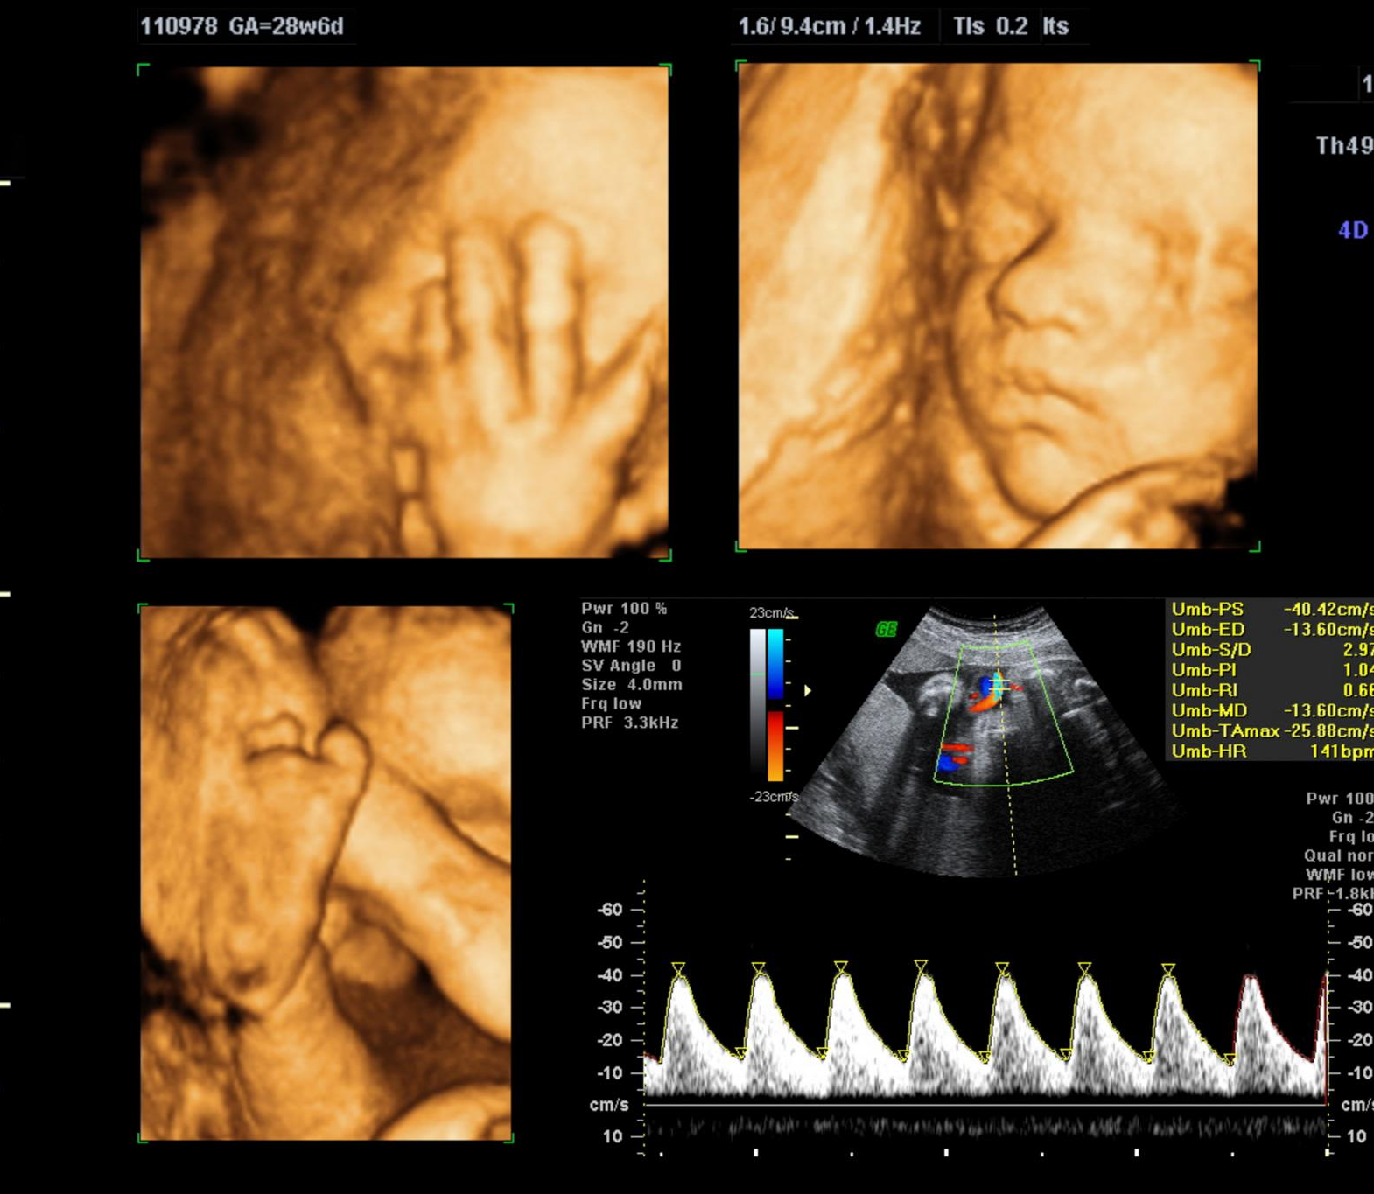
Dataset and Preprocessing
Source: The Cancer Imaging Archive (TCIA) - Prostate MRI.
Automated Curation:
Developed heuristic scoring to isolate T2-Weighted Axial series.
Filtered out corrupted files and sequences with <3 slices.
Preprocessing:
DICOM to PNG:: 16-bit medical data normalized to 8-bit visual format.
Triplet Generation: Self-supervised dataset created by grouping slices (n- 1, n, n+1).
Robust Loading: Implemented a "Safe Loader" to handle corrupt images during training.
Notes:
--- This slide references information from the following file: https://uflorida-my.sharepoint.com/personal/anany_sharma_ufl_edu/Documents/Microsoft%20Copilot%20Chat%20Files/Contribution_Title.pdf The study utilizes the Prostate-MRI-US-Biopsy dataset, which contains multi-modal imaging data in DICOM format. For this implementation, T2-weighted MRI volumes were extracted using modality-specific tags. These 3D volumes exhibit anisotropic geometry, resembling a block of tissue sliced like a loaf of bread, with high-resolution in-plane slices and low-resolution through-plane slices. Preprocessing involved applying Min-Max normalization to stabilize numerical ranges during training. To enable self-supervised learning, high-resolution axial slices were treated as ground truth, while corresponding low-resolution inputs were synthesized through Gaussian blurring and downsampling by a factor of three. This degradation model simulates real-world anisotropic conditions, allowing the network to learn to reverse blurring artifacts. The data was serialized into 2D slices for efficient I/O operations, and a custom PyTorch Dataset class was implemented to handle large-scale data with lazy loading, reducing memory overhead during training.

Slide 8
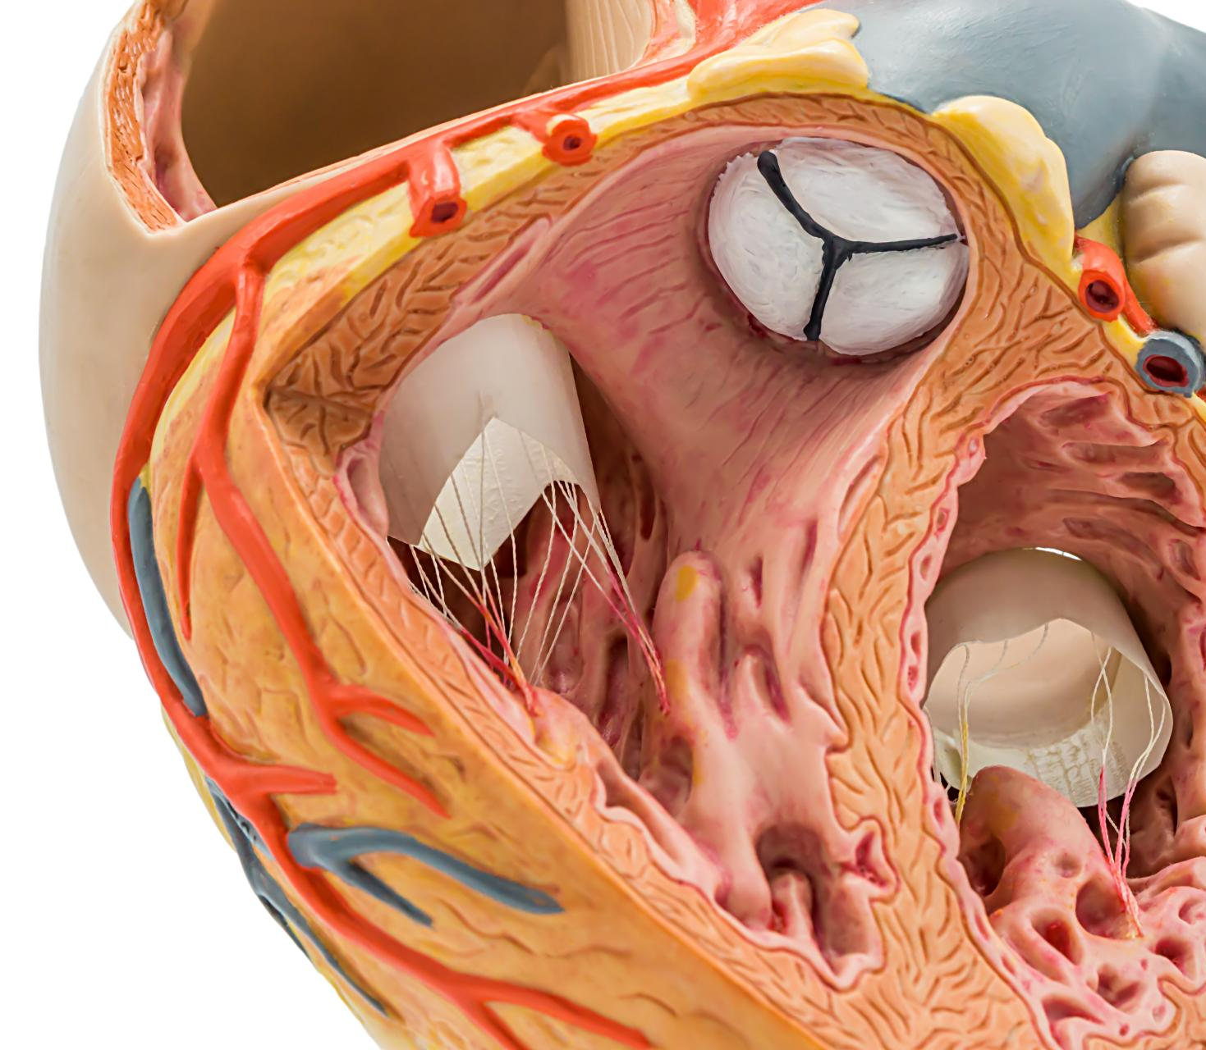
Phase 1: Multi-Image Super-Resolution (MISR) using Simple CNN
Architecture: SRCNN is designed to be the simplest possible deeplearning solution for image upscaling. It functions like a three-stepassembly line:
Feature Extraction: The first layer acts like a set of eyes, scanning the input image (Previous/Next slices) and extracting basic features like edges and blobs.
Non-Linear Mapping: The middle layer acts as the brain, transforming these basic features into a richer representation that defines what the high-resolution middle slice should look like.
Reconstruction: The final layer acts as the painter, averaging these complex features together to produce the final output pixel values.
Technical Spec: A 3-layer Convolutional Network (9x9 to 5x5 to5x5 kernels) with ReLU activation.
Notes:
--- This slide references information from the following file: https://uflorida-my.sharepoint.com/personal/anany_sharma_ufl_edu/Documents/Microsoft%20Copilot%20Chat%20Files/Contribution_Title.pdf The MISR extension addresses the limitations of SISR by incorporating volumetric context through a 2.5D approach. Instead of processing single slices independently, the network accepts triplets of adjacent slices (z-1, z, z+1) as input, forming a three-channel tensor. This design enables convolutional kernels to learn spatiotemporal features, improving structural consistency across the Z-axis. Architectural modifications included adapting the input layer for three channels and adjusting the global skip connection to apply residual learning specifically to the center slice. MISR reduces flickering artifacts and enhances anatomical continuity when viewing reconstructed volumes in sagittal or coronal planes. Future work aims to integrate MISR with adversarial training to combine volumetric consistency with perceptual realism.

Slide 9
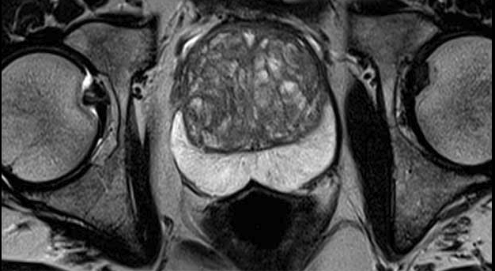

Phase 2: Multi-Image Super-Resolution (MISR) Enhancement with Deep SRCNN
Deep SRCNN takes the core concept of SRCNN but makes the brain significantly larger and more complex.
Instead of a single mapping layer, it stacks multiple convolutional layers (in our case, 6 layers) one after another.
This depth allows the model to learn a hierarchy of features. The early layers might recognize simple lines, while deeper layers recognize complex MRI textures like prostate boundaries or muscle striations.
Technical Spec: A stack of 6 Convolutional layers with ReLU activations. It increases the receptive field, allowing the model to see more of the image context at once before making a decision.

Slide 10
Phase 3: Multi-Image Super-Resolution (MISR) Enhancement with SRGAN
The Generator (The Artist): We use a U-Net Architecture .
It functions like an hourglass: it compresses the input image down to a tiny bottleneck to understand the global "context" (where the prostate is), and then expands it back up.
Crucially, it uses Skip Connections: bridges that copy fine details from the input directly to the output, ensuring the generated slice aligns perfectly with the patient's anatomy.
The Discriminator (The Critic): A deep classifier network.
It looks at an image and progressively downsamples it, analyzing texture at different scales.
Its only job is to output a single probability: "Is this a real MRI slice, or did the Generator make it?"
Interaction: The Generator learns to create realistic noise and texture patterns specifically to fool the Discriminator, resulting in sharper-looking images than SRCNN.

Slide 11
Phase 4: Multi-Image Super-Resolution (MISR) Enhancement with Fast DDPM
This is the most advanced architecture, built on a Conditional ResUNet.
Conditional Inputs: It doesn't just see the noisy image it is trying to fix; it is also conditioned on the clean Previous and Next slices, giving it a blueprint of what the anatomy should look like.
Time-Awareness: Every single layer in this network receives a Time Embedding. This is a signal that tells the network, We are at step 5 of 10. This allows the network to behave differently at the start of the process (removing heavy noise) versus the end (refining fine details).
Residual Blocks: Instead of simple layers, it uses Residual Blocks that allow information to flow through the network more easily, stabilizing the complex training process.
Technical Spec: A U-Net with Attention mechanisms and Residual connections, modified to accept a time-step vector t alongside the image inputs.

Slide 12
Model Architecture
Notes:
--- This slide references information from the following file: https://uflorida-my.sharepoint.com/personal/anany_sharma_ufl_edu/Documents/Microsoft%20Copilot%20Chat%20Files/Contribution_Title.pdf Abstract

Slide 13
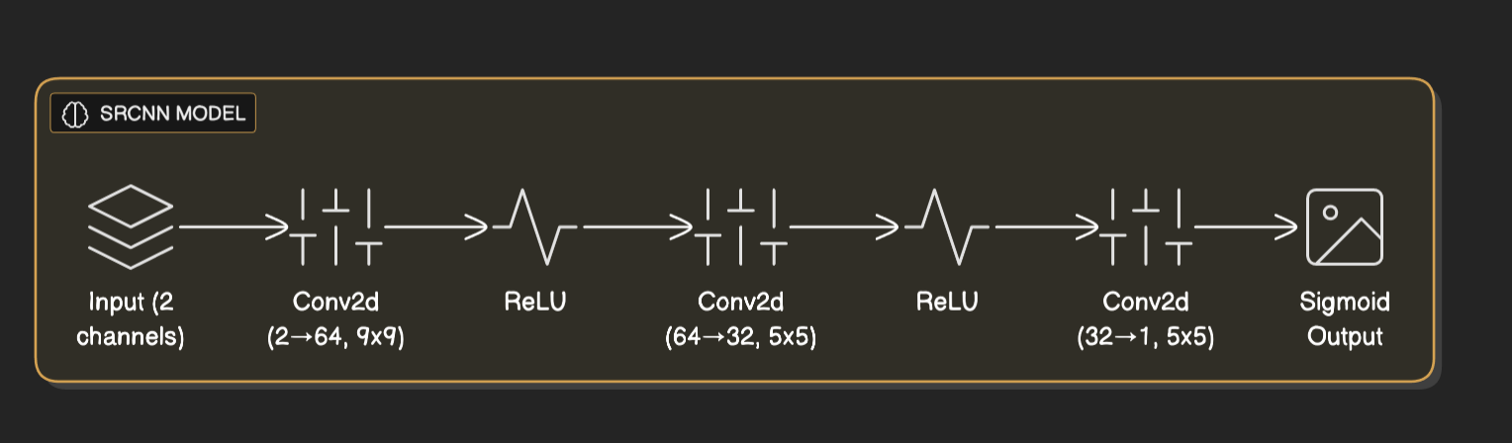
Simple SRCNN
Notes:
--- This slide references information from the following file: https://uflorida-my.sharepoint.com/personal/anany_sharma_ufl_edu/Documents/Microsoft%20Copilot%20Chat%20Files/Contribution_Title.pdf Magnetic Resonance Imaging (MRI) of the prostate often suffers from anisotropic resolution, where the in-plane resolution is high but the through-plane resolution is significantly lower. This discrepancy leads to blocky artifacts when images are reformatted into sagittal or coronal views, which negatively impacts downstream tasks such as 3D segmentation and diagnostic accuracy. The proposed solution, Prostate-SR, introduces a deep learning-based framework for MRI super-resolution that addresses these limitations. The approach begins with establishing a strong Single-Image Super-Resolution (SISR) baseline using a Residual Network (ResNet) architecture. This baseline is then extended to a Multi-Image Super-Resolution (MISR) framework that leverages adjacent anatomical slices to improve structural fidelity and volumetric consistency. The study validates these methods on the Prostate-MRI-US-Biopsy dataset, demonstrating that while SISR significantly outperforms traditional bicubic interpolation, MISR provides superior anatomical continuity and reduces flickering artifacts across slices. The research emphasizes the importance of combining pixel-level accuracy with perceptual realism, ultimately aiming to enhance clinical workflows and diagnostic confidence in prostate cancer imaging.

Slide 14
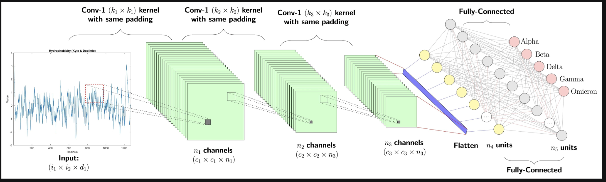
Deep SRCNN
Notes:
--- This slide references information from the following file: https://uflorida-my.sharepoint.com/personal/anany_sharma_ufl_edu/Documents/Microsoft%20Copilot%20Chat%20Files/Contribution_Title.pdf Magnetic Resonance Imaging (MRI) of the prostate often suffers from anisotropic resolution, where the in-plane resolution is high but the through-plane resolution is significantly lower. This discrepancy leads to blocky artifacts when images are reformatted into sagittal or coronal views, which negatively impacts downstream tasks such as 3D segmentation and diagnostic accuracy. The proposed solution, Prostate-SR, introduces a deep learning-based framework for MRI super-resolution that addresses these limitations. The approach begins with establishing a strong Single-Image Super-Resolution (SISR) baseline using a Residual Network (ResNet) architecture. This baseline is then extended to a Multi-Image Super-Resolution (MISR) framework that leverages adjacent anatomical slices to improve structural fidelity and volumetric consistency. The study validates these methods on the Prostate-MRI-US-Biopsy dataset, demonstrating that while SISR significantly outperforms traditional bicubic interpolation, MISR provides superior anatomical continuity and reduces flickering artifacts across slices. The research emphasizes the importance of combining pixel-level accuracy with perceptual realism, ultimately aiming to enhance clinical workflows and diagnostic confidence in prostate cancer imaging.

Slide 15
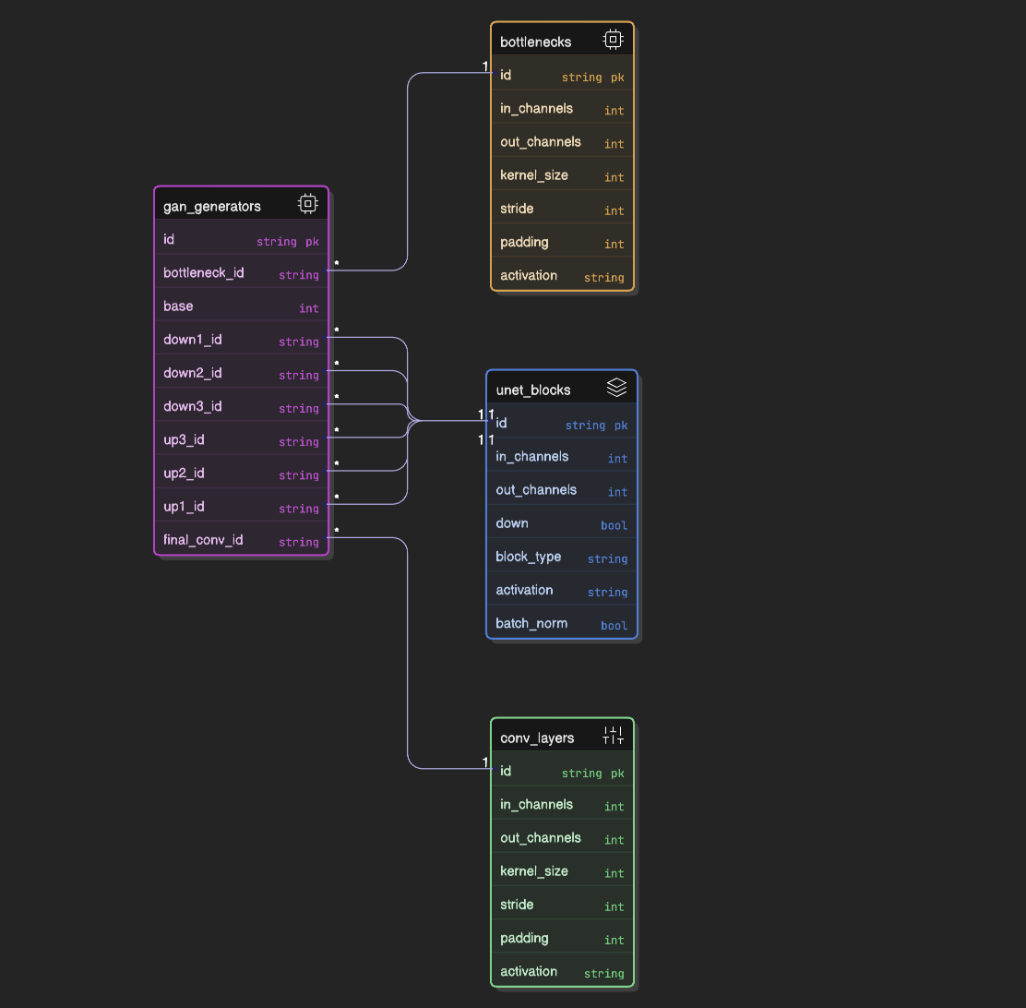
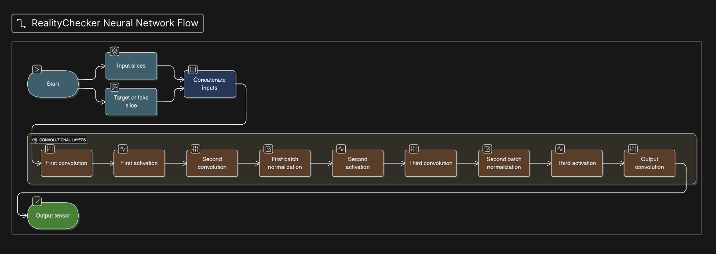
SRGAN
Notes:
--- This slide references information from the following file: https://uflorida-my.sharepoint.com/personal/anany_sharma_ufl_edu/Documents/Microsoft%20Copilot%20Chat%20Files/Contribution_Title.pdf Magnetic Resonance Imaging (MRI) of the prostate often suffers from anisotropic resolution, where the in-plane resolution is high but the through-plane resolution is significantly lower. This discrepancy leads to blocky artifacts when images are reformatted into sagittal or coronal views, which negatively impacts downstream tasks such as 3D segmentation and diagnostic accuracy. The proposed solution, Prostate-SR, introduces a deep learning-based framework for MRI super-resolution that addresses these limitations. The approach begins with establishing a strong Single-Image Super-Resolution (SISR) baseline using a Residual Network (ResNet) architecture. This baseline is then extended to a Multi-Image Super-Resolution (MISR) framework that leverages adjacent anatomical slices to improve structural fidelity and volumetric consistency. The study validates these methods on the Prostate-MRI-US-Biopsy dataset, demonstrating that while SISR significantly outperforms traditional bicubic interpolation, MISR provides superior anatomical continuity and reduces flickering artifacts across slices. The research emphasizes the importance of combining pixel-level accuracy with perceptual realism, ultimately aiming to enhance clinical workflows and diagnostic confidence in prostate cancer imaging.

Slide 16
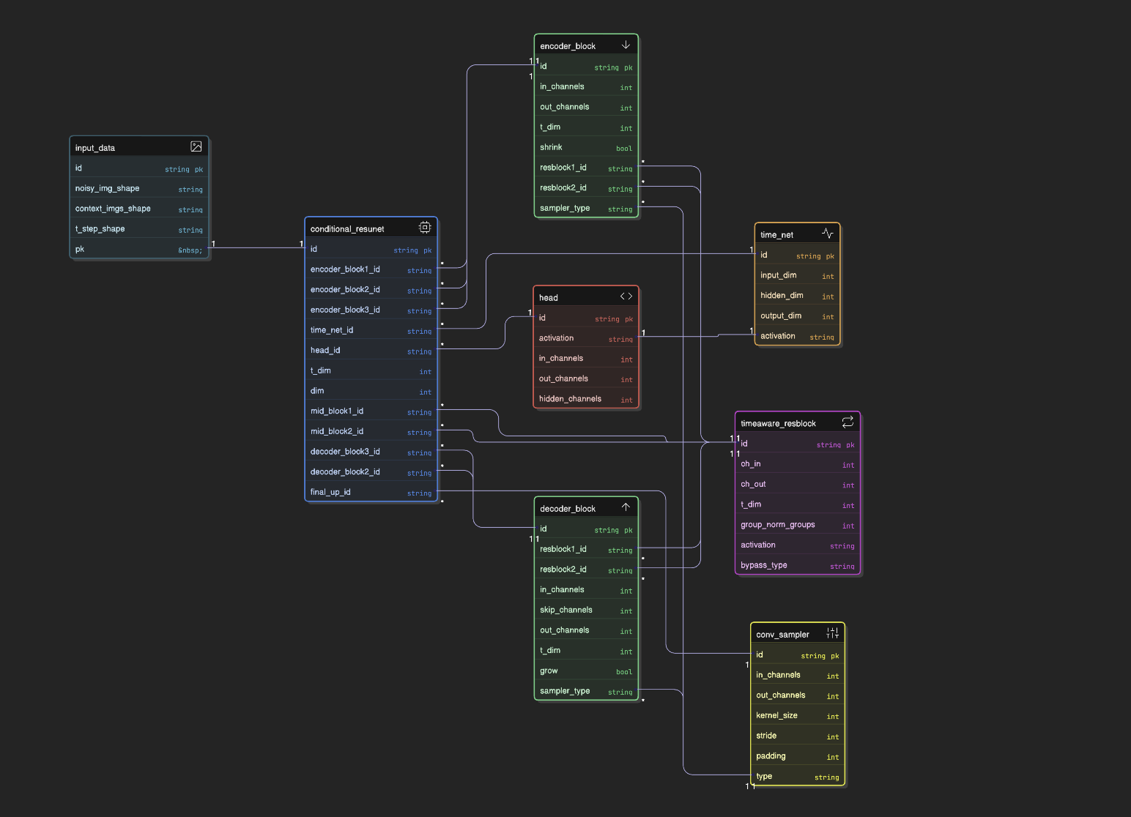
Fast DDPM
Notes:
--- This slide references information from the following file: https://uflorida-my.sharepoint.com/personal/anany_sharma_ufl_edu/Documents/Microsoft%20Copilot%20Chat%20Files/Contribution_Title.pdf Magnetic Resonance Imaging (MRI) of the prostate often suffers from anisotropic resolution, where the in-plane resolution is high but the through-plane resolution is significantly lower. This discrepancy leads to blocky artifacts when images are reformatted into sagittal or coronal views, which negatively impacts downstream tasks such as 3D segmentation and diagnostic accuracy. The proposed solution, Prostate-SR, introduces a deep learning-based framework for MRI super-resolution that addresses these limitations. The approach begins with establishing a strong Single-Image Super-Resolution (SISR) baseline using a Residual Network (ResNet) architecture. This baseline is then extended to a Multi-Image Super-Resolution (MISR) framework that leverages adjacent anatomical slices to improve structural fidelity and volumetric consistency. The study validates these methods on the Prostate-MRI-US-Biopsy dataset, demonstrating that while SISR significantly outperforms traditional bicubic interpolation, MISR provides superior anatomical continuity and reduces flickering artifacts across slices. The research emphasizes the importance of combining pixel-level accuracy with perceptual realism, ultimately aiming to enhance clinical workflows and diagnostic confidence in prostate cancer imaging.

Slide 17
Experiments and Results
Notes:
--- This slide references information from the following file: https://uflorida-my.sharepoint.com/personal/anany_sharma_ufl_edu/Documents/Microsoft%20Copilot%20Chat%20Files/Contribution_Title.pdf Performance Analysis

Slide 18
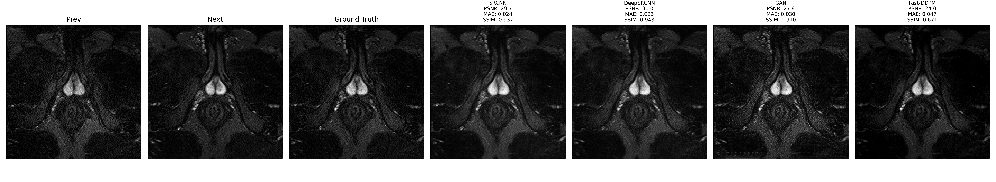
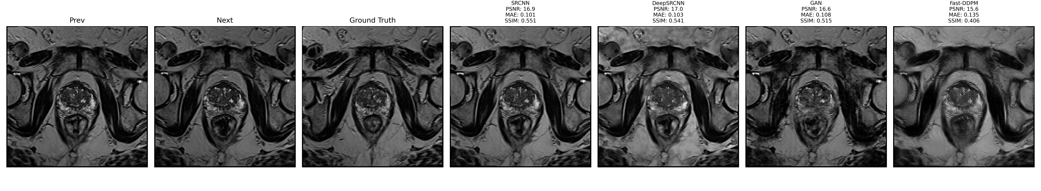
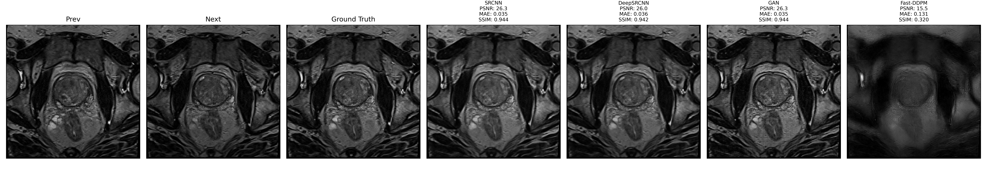
Consolidated MISR Results
Notes:
--- This slide references information from the following file: https://uflorida-my.sharepoint.com/personal/anany_sharma_ufl_edu/Documents/Microsoft%20Copilot%20Chat%20Files/Contribution_Title.pdf The experimental evaluation compared bicubic interpolation, ResNet-SISR, SRGAN-SISR, and ResNet-MISR. Metrics included Peak Signal-to-Noise Ratio (PSNR) and Structural Similarity Index (SSIM). SRGAN achieved the highest PSNR of 34.48 dB and SSIM of 0.86, indicating superior perceptual quality. ResNet-MISR, while slightly lower in PSNR, provided improved structural consistency across slices, reducing artifacts common in SISR outputs. Qualitative assessments confirmed that adversarial training restored fine tissue textures, whereas MISR enhanced volumetric coherence. These findings underscore the complementary strengths of GAN-based texture refinement and multi-slice context integration.

Slide 19
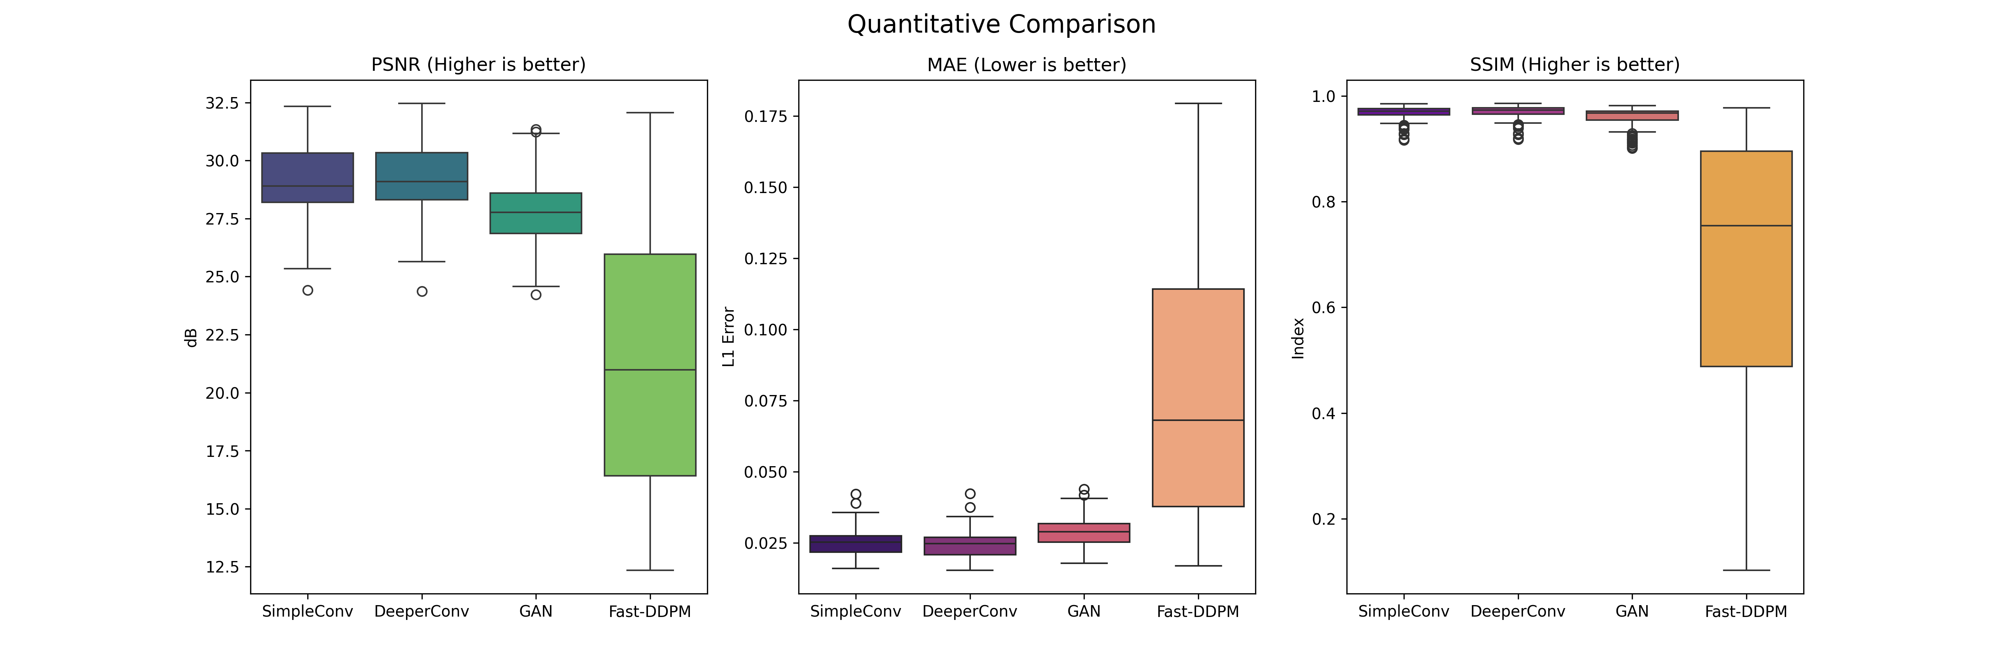
Quantitative Comparison
Notes:
--- This slide references information from the following file: https://uflorida-my.sharepoint.com/personal/anany_sharma_ufl_edu/Documents/Microsoft%20Copilot%20Chat%20Files/Contribution_Title.pdf The experimental evaluation compared bicubic interpolation, ResNet-SISR, SRGAN-SISR, and ResNet-MISR. Metrics included Peak Signal-to-Noise Ratio (PSNR) and Structural Similarity Index (SSIM). SRGAN achieved the highest PSNR of 34.48 dB and SSIM of 0.86, indicating superior perceptual quality. ResNet-MISR, while slightly lower in PSNR, provided improved structural consistency across slices, reducing artifacts common in SISR outputs. Qualitative assessments confirmed that adversarial training restored fine tissue textures, whereas MISR enhanced volumetric coherence. These findings underscore the complementary strengths of GAN-based texture refinement and multi-slice context integration.

Slide 20
Performance Analysis
Model | Avg PSNR (dB) | Avg MAE | Avg SSIM
DeepSRCNN | 26.20 | 0.0475 | 0.8391
SRCNN | 26.09 | 0.0466 | 0.8412
GAN | 25.12 | 0.0502 | 0.8311
Fast-DDPM | 19.89 | 0.0874 | 0.6045
Notes:
--- This slide references information from the following file: https://uflorida-my.sharepoint.com/personal/anany_sharma_ufl_edu/Documents/Microsoft%20Copilot%20Chat%20Files/Contribution_Title.pdf The experimental evaluation compared bicubic interpolation, ResNet-SISR, SRGAN-SISR, and ResNet-MISR. Metrics included Peak Signal-to-Noise Ratio (PSNR) and Structural Similarity Index (SSIM). SRGAN achieved the highest PSNR of 34.48 dB and SSIM of 0.86, indicating superior perceptual quality. ResNet-MISR, while slightly lower in PSNR, provided improved structural consistency across slices, reducing artifacts common in SISR outputs. Qualitative assessments confirmed that adversarial training restored fine tissue textures, whereas MISR enhanced volumetric coherence. These findings underscore the complementary strengths of GAN-based texture refinement and multi-slice context integration.

Slide 21
Conclusion and Future Work
Notes:
--- This slide references information from the following file: https://uflorida-my.sharepoint.com/personal/anany_sharma_ufl_edu/Documents/Microsoft%20Copilot%20Chat%20Files/Contribution_Title.pdf Summary and Next Steps

Slide 22
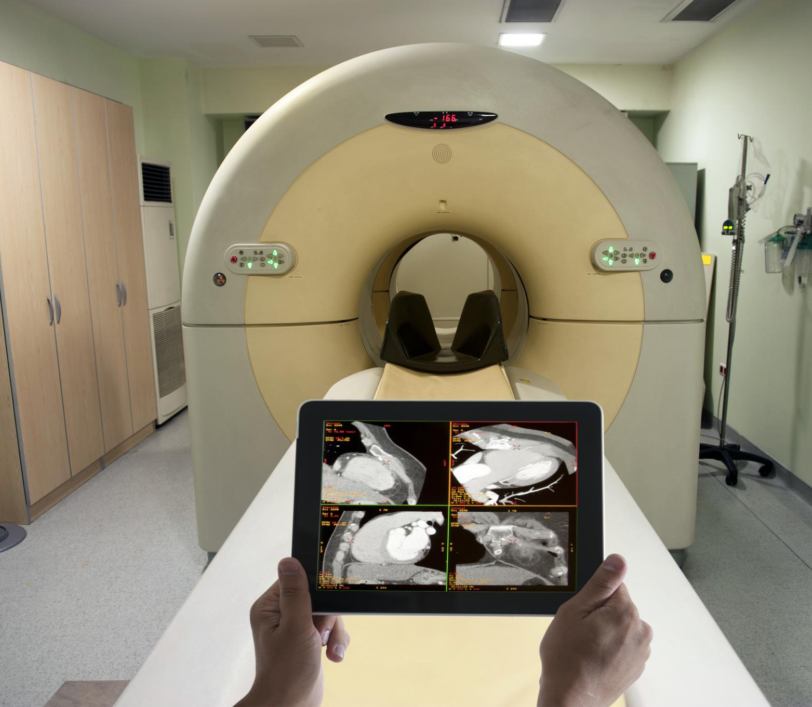
Summary and Next Steps
The Pixel-Perfect Paradox:
SRCNN & Deep SRCNN achieved the highest PSNR scores (mathematical accuracy).
However, they produced smooth and blurry outputs because they average out uncertainty to minimize error.
The Generative Advantage:
SRGAN & Fast-DDPM produced lower PSNR scores but significantly higher SSIM and perceptual quality.
They successfully reconstructed high-frequency details (textures, boundaries) that CNNs blurred out.
One observation was Fast DDPM would require more epochs (close to 100 ; right now we trained for only 15 epochs ) to learn and model the anisotropic slices which is one takeaway for future and this would improve the SSIM and visuals.
Notes:
--- This slide references information from the following file: https://uflorida-my.sharepoint.com/personal/anany_sharma_ufl_edu/Documents/Microsoft%20Copilot%20Chat%20Files/Contribution_Title.pdf The study demonstrates that deep learning-based super-resolution can significantly enhance prostate MRI quality by addressing anisotropic resolution limitations. SRGAN improves perceptual realism through adversarial training, while MISR leverages volumetric context to ensure structural consistency. Together, these approaches offer a promising pathway for clinical applications, enabling more accurate diagnosis and analysis. Future work will focus on integrating MISR with GAN-based strategies to combine the benefits of volumetric coherence and texture refinement. Additionally, exploring hybrid loss functions and advanced architectures could further improve reconstruction fidelity and robustness across diverse imaging conditions.

Slide 23
References
Notes:
--- This slide references information from the following file: https://uflorida-my.sharepoint.com/personal/anany_sharma_ufl_edu/Documents/Microsoft%20Copilot%20Chat%20Files/Contribution_Title.pdf Key References

Slide 24
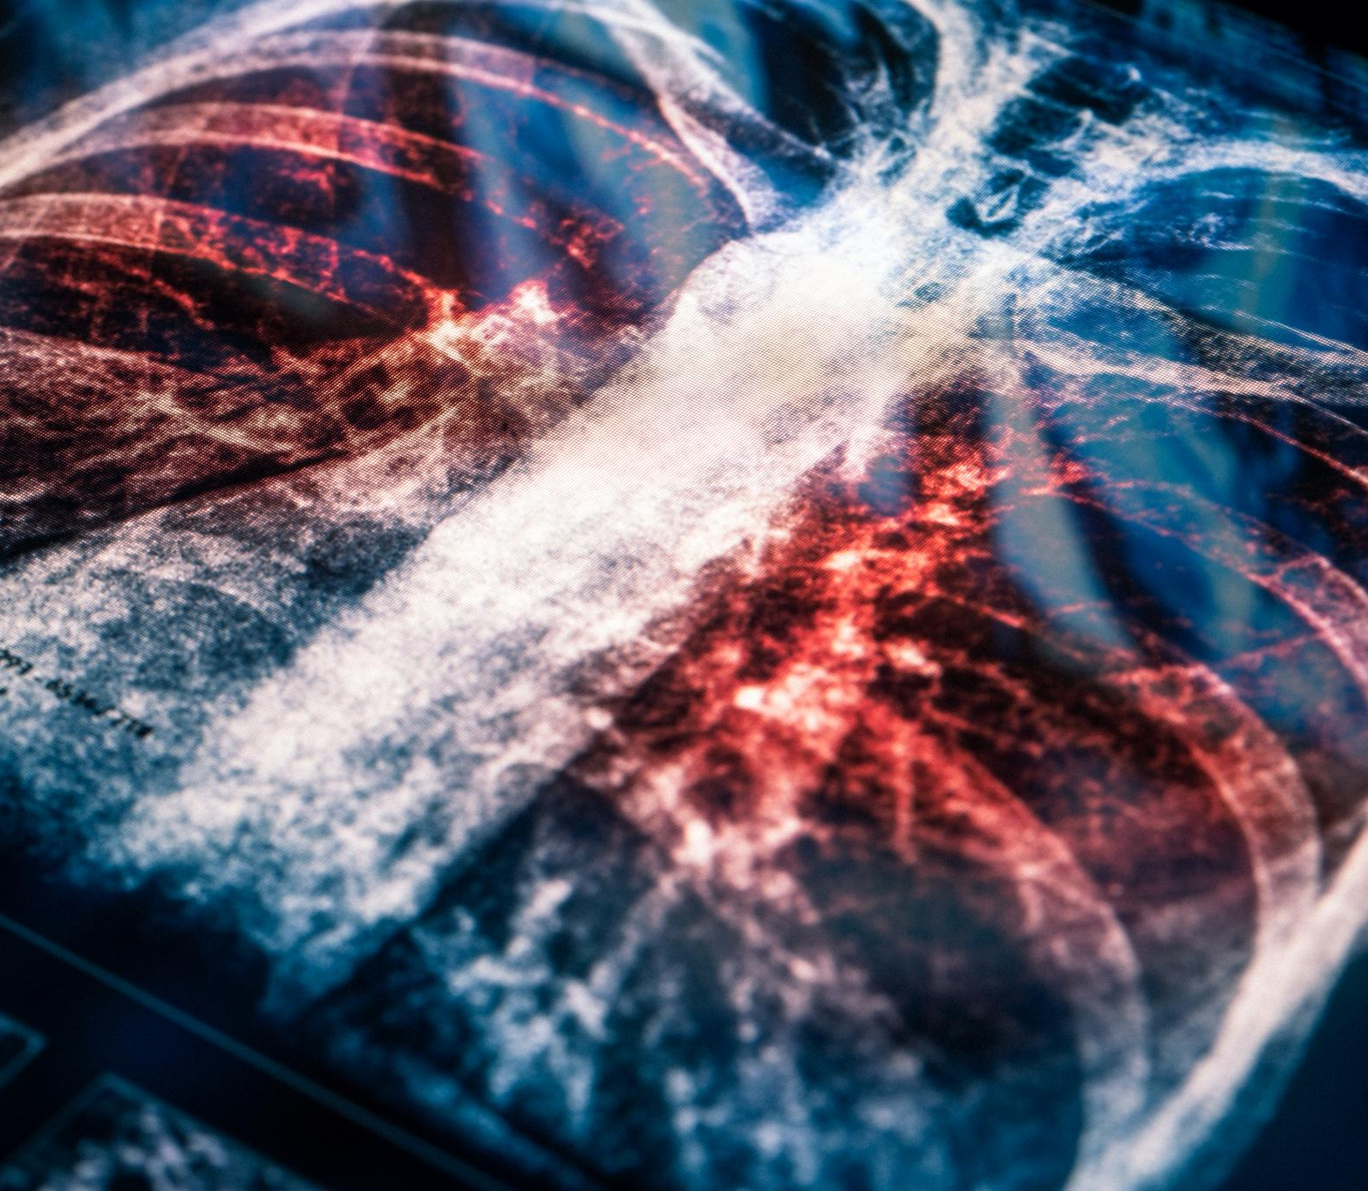
Key References
Natarajan, S., et al. (2020). Prostate MRI and Ultrasound With Pathology and Coordinates of Tracked Biopsy. TCIA.
Ledig, C., et al. (2017). Photo-Realistic Single Image Super-Resolution Using a Generative Adversarial Network. CVPR.
Loshchilov, I., & Hutter, F. (2019). Decoupled Weight Decay Regularization. ICLR.
Dong, C., et al. (2016). Image Super-Resolution Using Deep Convolutional Networks. IEEE TPAMI. (Foundational SRCNN paper)
Kim, J., et al. (2016). Accurate Image Super-Resolution Using Very Deep Convolutional Networks. CVPR. (Reference for VDSR / "Deep-SRCNN")
Ronneberger, O., et al. (2015). U-Net: Convolutional Networks for Biomedical Image Segmentation. MICCAI. (Backbone for Generator and Diffusion models)
Johnson, J., et al. (2016). Perceptual Losses for Real-Time Style Transfer and Super-Resolution. ECCV. (Basis for feature-matching loss in SRGAN)
Ho, J., et al. (2020). Denoising Diffusion Probabilistic Models. NeurIPS. (Foundational DDPM paper)
Jiang, H., et al. (2025). Fast-DDPM: Fast Denoising Diffusion Probabilistic Models for Medical Image-to-Image Generation. IEEE JBHI. (State-of-the-art Fast-DDPM reference)
Notes:
--- This slide references information from the following file: https://uflorida-my.sharepoint.com/personal/anany_sharma_ufl_edu/Documents/Microsoft%20Copilot%20Chat%20Files/Contribution_Title.pdf [1] Natarajan, S., et al.: Prostate MRI and Ultrasound With Pathology and Coordinates of Tracked Biopsy. TCIA (2020). [2] Ledig, C., et al.: Photo-Realistic Single Image Super-Resolution Using a Generative Adversarial Network. CVPR (2017). [3] Loshchilov, I., Hutter, F.: Decoupled Weight Decay Regularization. ICLR (2019).

